Slide 1
Chapter 14
Nouman M Durrani

Slide 2
Real-Address Mode
Real-address mode (16-bit mode) programs have the following characteristics:
Max 1 megabyte addressable RAM
Single tasking: Single task can be performed in a single session
No memory boundary protection is possible
IBM PC-DOS: first real-address OS for IBM-PC
Later renamed to MS-DOS, owned by Microsoft

Slide 3
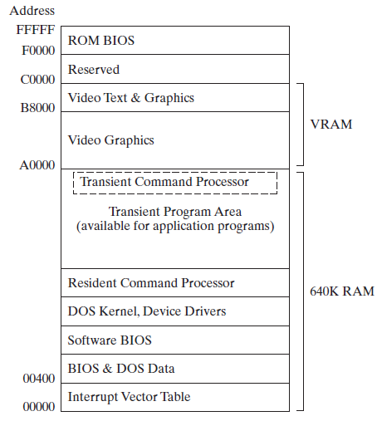

Slide 4
In real-address mode, the lowest 640K of memory is used by both the operating system and application programs.
Following this is the video memory and reserved memory for hardware controllers.
Finally, locations F0000 to FFFFF are reserved for system ROM (read-only memory) BIOS.

Slide 5
Within the operating system area of memory, the lowest 1024 bytes of memory (addresses 00000 to 003FF) contain a table of 32-bit addresses named the interrupt vector table.
These addresses, called interrupt vectors, are used by the CPU when processing hardware and software interrupts.

Slide 6
BIOS and MS-DOS data area are present just above the vector table.
Software BIOS includes procedures that manage most I/O devices, including the keyboard, disk drive, video display, serial, and printer ports.
BIOS procedures are loaded on an MS-DOS system (boot) disk.
BIOS is non-volatile firmware (permanent software programmed into a read-only memory) used to perform hardware initialization during the booting process, and to provide runtime services for operating systems and programs.
It also manages data flow between the computer's operating system and attached devices such as the hard disk, video adapter, keyboard, mouse and printer.

Slide 7
The command processor interprets commands typed at the MS-DOS prompt and loads and executes programs stored on disk.
The resident part of the command processor is loaded from an executable file named command.com.
A second part of the command processor occupies high memory just below location A0000.
Application programs can load into memory at the first address above the resident part of the command processor and can use memory all the way up to address 9FFFF

Slide 8
The MS-DOS kernel is a collection of procedures (called services) that are also loaded from a file on the system disk.
The DOS Kernel performs the following functions:
File and record management
Memory management
Character device input/output
Spawning other programs
Access to real-time clock
The DOS kernel components are contained in the MSDOS.SYS (or IBMDOS.COM) system file.
Programs communicate with the kernel via software interrupts.

Slide 9
The Command Processor
The DOS command processor is not the operating system, but rather a special class of program running under control of the MS-DOS kernel. Its major function is to provide the DOS user interface (UI).
The DOS command processor (also known as Shell and a Command interpreter), COMMAND.COM,-- is responsible for parsing and carrying out user commands, including both internal and external commands.
Programming code for internal (Resident) commands is contained within COMMAND.COM itself.
While code for external(Transient) commands resides in disk files and must be loaded into primary memory (RAM) before being executed.

Slide 11
Hardware and Software Interrupts
A Hardware Interrupt is a signal generated by any part of the system hardware that needs immediate attention from the CPU.
A software interrupt is a call to an operating system procedure.
Most of these procedures, called interrupt handlers, provide input-output capability to application programs.
They are used for such tasks as the following:
Displaying characters and strings
Reading characters and strings from the keyboard
Displaying text in color
Opening and closing files
Reading data from files
Writing data to files
Setting and retrieving the system time and date

Slide 12
INT Instruction
The INT ( call to interrupt procedure) instruction calls a system subroutine also known as an interrupt handler
Before the INT instruction executes, one or more parameters must be inserted in registers.
a number identifying the particular procedure must be moved to the AH register.
The syntax is
INT number
where number is an integer in the range 0 to FF hexadecimal.

Slide 13
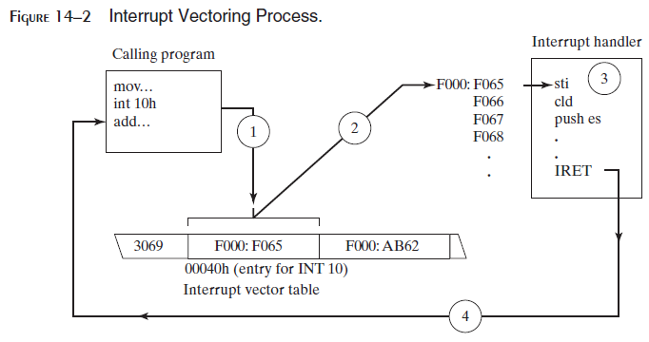
Interrupt Vectoring
The CPU processes the INT instruction using the interrupt vector table
table of addresses in the lowest 1024 bytes of memory.
Each entry in this table is a 32-bit segment-offset address that points to an interrupt handler.
Figure 14–2 illustrates the steps taken by the CPU when the INT instruction is invoked by a program:
Step 1: The operand of the INT instruction is multiplied by 4 to locate the matching interrupt vector table entry.
Step 2: The CPU pushes the flags and a 32-bit segment/offset return address on the stack, disables hardware interrupts, and executes a far call to the address stored at location (10h * 4) in the interrupt vector table (F000:F065).
Step 3: The interrupt handler at F000:F065 executes until it reaches an IRET (interrupt return) instruction.
Step 4: The IRET instruction pops the flags and the return address off the stack, causing the processor to resume execution immediately following the INT 10h instruction in the calling program.

Slide 15
INT Vectors: Example
Main proc
MOV AX,@data
MOV DS, AX
…
…
INT 21h
Main endp
PUSH DX
PUSH CX
…
…
IP
CS
0h
4h
×4
…
…
84h
…
…
3FFh

Slide 16
Common Interrupts
Software interrupts call interrupt service routines (ISRs) either in the BIOS or in DOS.
Some frequently used interrupts are the following:
INT 10h Video Services: Procedures that display routines that control the cursor position, write text in color, scroll the screen, and display video graphics.
INT 16h Keyboard Services: Procedures that read the keyboard and check its status.
INT 17h Printer Services: Procedures that initialize, print, and return the printer status.

Slide 17
INT 1Ah Time of Day: Procedure that gets the number of clock ticks since the machine was turned on or sets the counter to a new value.
INT 1Ch User Timer Interrupt: An empty procedure that is executed 18.2 times per second.
INT 21h MS-DOS Services: Procedures that provide input-output, file handling, and memory management.
Also known as MS-DOS function calls.

Slide 18
Function 4Ch of INT 21h
Terminate process:
Ends the current process (program), returns an optional 8-bit return code to the calling process.
A return code of 0 usually indicates successful completion.
mov ah,4Ch ; terminate process
mov al,0 ; return code
int 21h
; Same as:
.EXIT 0

Slide 19
Example of INT for I/O
INT 21h: invoke MS-DOS services
Function code in AH, e.g. 09H = write string
The string must be terminated by a '$' character.
DS must point to the string's segment, and DX must contain the string's offset.
.data
string BYTE “Hello, World!$"
.code
mov ah,9h
mov dx,OFFSET string
int 21h

Slide 20
Selected I/O Functions
Output functions:
02h, 06h - Write character to standard output
05h - Write character to default printer
09h - Write string to standard output
40h - Write string to file or device
Input functions:
01h, 06h - Read character from standard input
0Ah - Read array of buffered characters from standard input
0Bh - Get status of the standard input buffer
3Fh - Read from file or device

Slide 21
INT 21h Function 05h
Write character to default printer
Write the letter 'A':
Write a horizontal tab:
mov ah,05h
mov dl,65
int 21h
mov ah,05h
mov dl,09h
int 21h

Slide 22
INT 21h Function 40h
Write string to file or device
BX = file or device handle (console = 1), CX = # bytes to write, DS:DX = address of array
.data
message "Writing a string to the console"
bytesWritten WORD ?
.code
mov ah,40h
mov bx,1
mov cx,LENGTHOF message
mov dx,OFFSET message
int 21h
mov bytesWritten,ax

Slide 23
INT 21h Function 01h
Read single character from standard input
Echoes the input character
Waits for input if the buffer is empty
Checks for Ctrl-Break (^C)
Acts on control codes such as horizontal Tab
.data
char BYTE ?
.code
mov ah,01h
int 21h
mov char,al

Slide 24
Example: Hello World!
.model small
.stack 100h
.386
.data
message BYTE "Hello, world!",0dh,0ah
.code
main PROC
mov ax,@data ; initialize DS
mov ds,ax
mov ah,40h ; write to file/device
mov bx,1 ; output handle
mov cx,SIZEOF message ; number of bytes
mov dx,OFFSET message ; addr of buffer
int 21h
.exit
main ENDP
END main

Slide 25
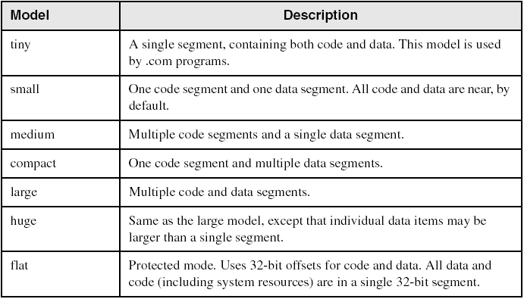
Memory Models
(Table 8-2, page 247)

